Slide 1
XGBoosting Regressor
- P.Hameed Femina

Slide 2
Outline
Introduction
Functionality
Algorithm

Slide 3
What is XGboosting Regressor
XGBoost is a scalable and highly accurate implementation of gradient boosting that pushes the limits of computing power for boosted tree algorithms, being built largely for energizing machine learning model performance and computational speed.

Slide 4
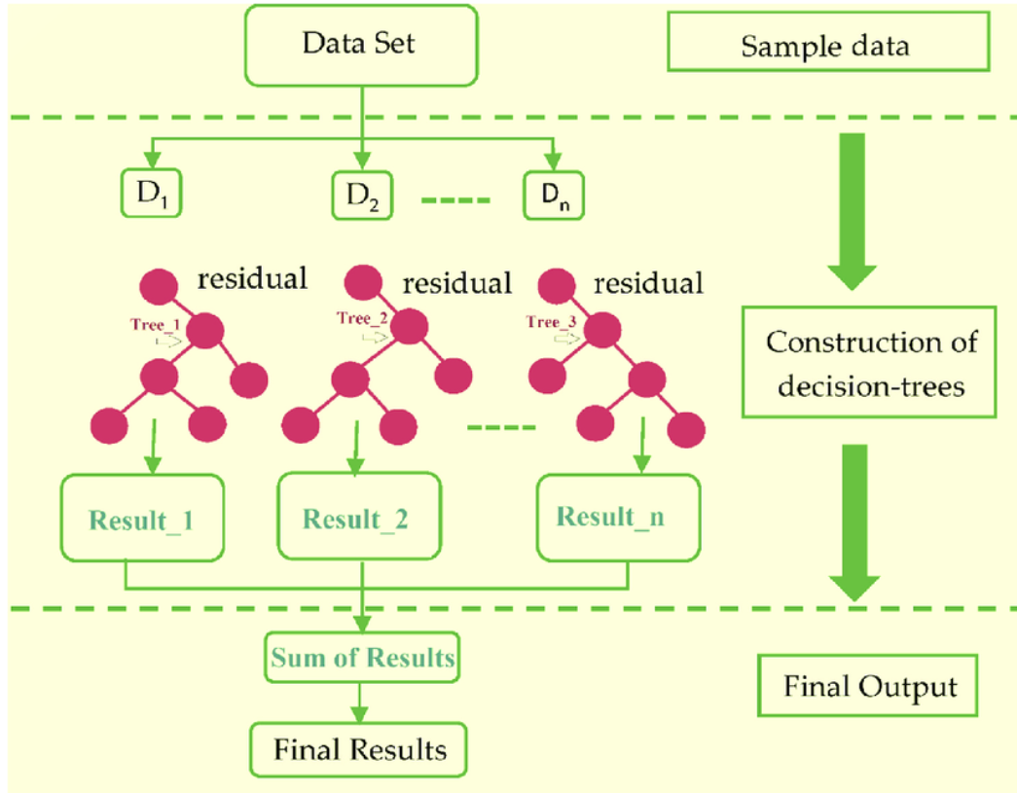

Slide 5
Advantage and Disadvantage
Advantage:
1. Regularization
-in-built L1 (Lasso Regression) and L2 (Ridge Regression) regularization
2. Parallel Processing
- nthread
3. Handling Missing Values
4. Effective Tree Pruning
Disavantage:
1. overfitting

Slide 6
Algorithm - syntax
Import xgboost as xg
XGBoosting_reg = XGBRegressor(objective=‘reg_linear’,n_estimators=10,seed=123)

Slide 7
Thankyou

